Slide 1
Unit 4 Energy & Power
Part C: Resistor Power Ratings
Notes:
Hi! Welcome to Unit 3: Resistance and Ohm’s Law, Part A on Resistance.

Slide 2
What will you learn?
What “power rating” is.
Select proper power rating of a resistor.

Slide 3
When current flows through a resistor
The electrical energy is converted to heat and dissipated from the surface of the resistor.
If the heat generated is small, you won’t be able to feel the minute increment in the temperature.
If the current is kept increasing, the surface will get warmer.
A point will be reached when further increase in current eventually burns the resistor.
I
+
_
V
R

Slide 4
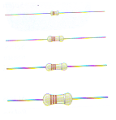
Power rating for a resistor
The maximum amount of power a resistor can dissipate without being damaged is called power rating.
Power rating is related to the resistor size: the larger the size, higher the power rating.
Common power rating values are ⅛ W, ¼ W, ½ W, and 1 W.
⅛W
¼W
½W
1W

Slide 5
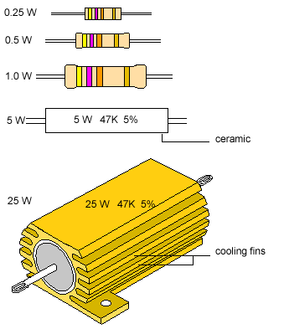
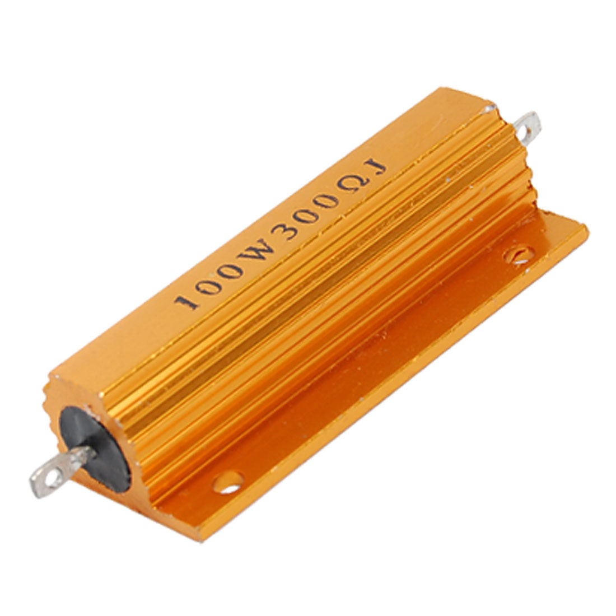
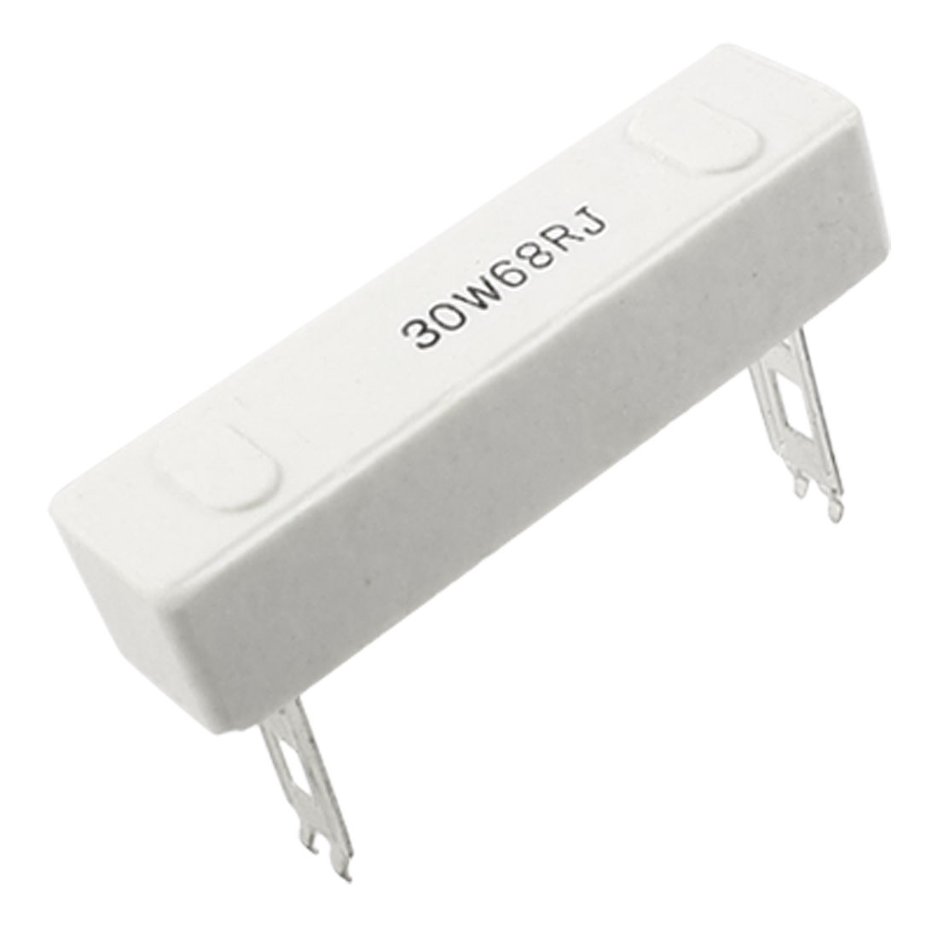
Resistor power ratings
Examples: Resistors showing different power ratings.
Common power rating values are ⅛ W, ¼ W, ½ W, and 1 W.
For resistors of higher power ratings, cooling fins are attached to the resistor surface to provide greater heat dissipation rate.

Slide 6

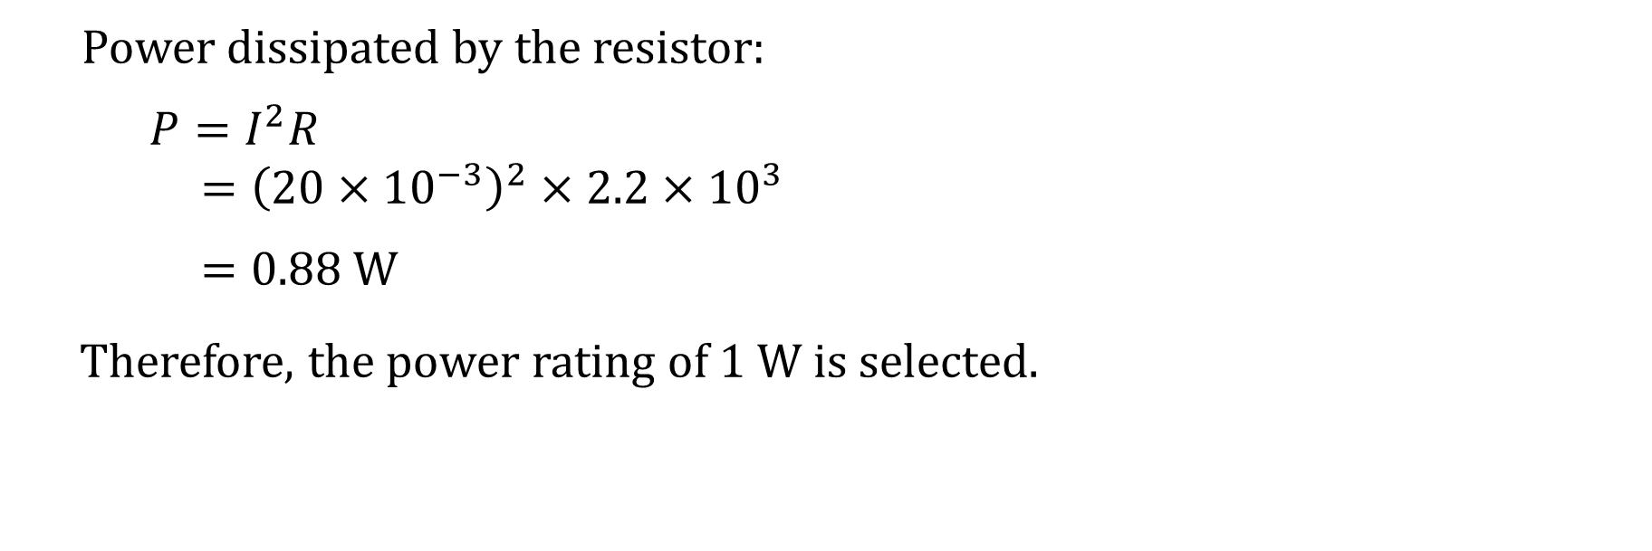
Example 1: A circuit requires 20 mA to flow through a 2.2 kΩ resistor. Select for the resistor an appropriate power rating from the available ratings of ⅛ W, ¼ W, ½ W, and 1 W.
Power dissipated by the resistor:
$$P=I^{2}R$$
$$={\left(20×{10}^{−3}\right)}^{2}×2.2×{10}^{3}$$
$$=0.88 W$$
Therefore, the power rating of 1 W is selected.
I
+
_
V
R
Notes:
You have a camera sitting beside you. Its screen view indicates a low battery. You retract it and notice a label on it reads: 3.7 V, 1000 mAh; Minimum 940 mAh or 3.5 Wh.
Another big question for you.

Slide 7
Selecting a resistor of proper power rating
The power rating selected for a resistor should be greater than the maximum power that the resistor is expected to handle.
For resistor dissipating 1 W or higher, a proper ventilation may be required to dissipate heat effectively.

Slide 8
You have learned that
The power rating of a resistor indicates the maximum power the resistor can handle.
In general, large the size of a resistor, higher its power rating.

Slide 9
Coming Up Next
Energy Conversion and Perfect Conductor

